Slide 1
Parallel and Distributed Computing
Communication in Networks

Slide 2
Today We Will learn,
Communication Unit
Communication Costs in Parallel Machines
Message Routing Techniques
Store-and-Forward Routing
Packet Routing
Cut-Through Routing

Slide 3
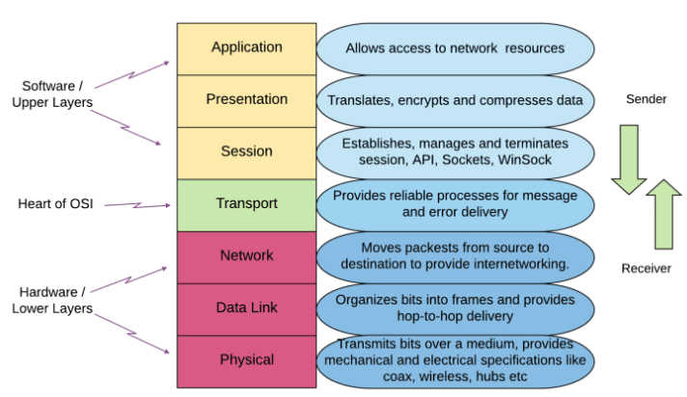
Network Layers Model (OSI) - Revisited
Typical Model showing the Layers of the Network

Slide 4
Communication Unit
Message:
the unit of communication from the programmer’s perspective.
Its size is limited only by the computer’s memory space
Packet:
Fixed-size small unit of communication containing routing information (e.g., a destination address) and sequencing information in its header.
Its size is of order hundred or thousands of bytes or words
Data sent over computer networks, such as the Internet, is divided into packets.
These packets are then recombined by the computer or device that receives them.
It consists of header flits and data flits

Slide 5
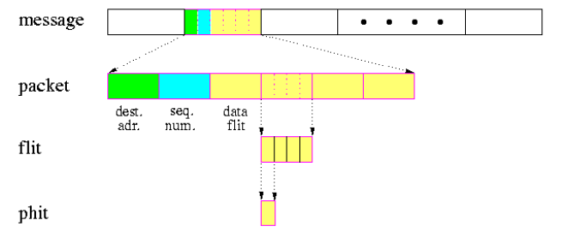
Illustration of Communication Unit
Flit: small unit of information at Link layer, of size of a few words
Phit: the smallest physical unit of information at the Physical Layer, which is transferred across one physical link in one cycle

Slide 6
Communication Unit
Congestion:
A state occurring in network layer when the message traffic is so heavy
that it slows down network response time.
As delay increases, performance decreases.
If delay increases, retransmission occurs, making situation worse.

Slide 7
Communication Unit
Router
A Router is a networking device that forwards data packets between computer network.
This device is usually connected to two or more different networks.
When a data packet comes to a router port, the router reads address information in packet to determine out which port the packet will be sent.
For example, a router provides you with the internet access by connecting your LAN with the Internet.

Slide 8
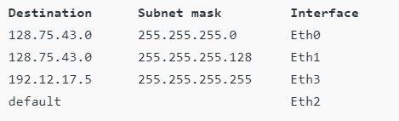
Communication Unit
Routing Table
Each router on the network supports a routing table in memory that may be simple or complex. In the simplest form, the table consists of pairs of IP addresses.
A routing table is a set of rules, often viewed in table format, that is used to determine where data packets traveling over an Internet Protocol (IP) network will be directed.
All IP-enabled devices, including routers and switches, use routing tables. See below a Routing Table:

Slide 9
Communication Costs in Parallel Machines
One of the major overheads in the execution of parallel programs arises from communication of information between processing elements.
The cost of communication is dependent on a variety of features including
Programming Model Semantics
Network Topology
Data Handling and Routing
Communication Software Protocols

Slide 10
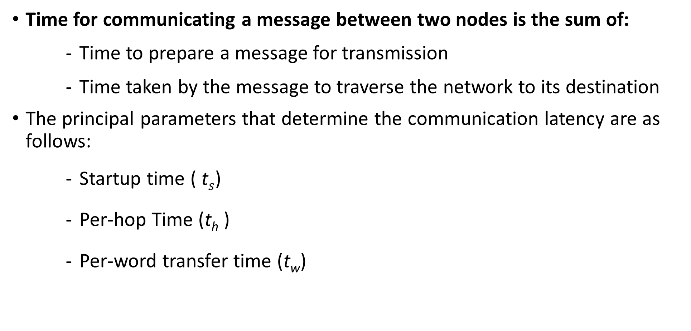
Major Parameters in Communication Costs (I)
Time for communicating a message between two nodes is the sum of:
Time to prepare a message for transmission
Time taken by the message to traverse the network to its destination
The principal parameters that determine the communication latency are as follows:
Startup time ( t$s$)
Per-hop Time (t_{h} )
Per-word transfer time (t_{w})

Slide 11
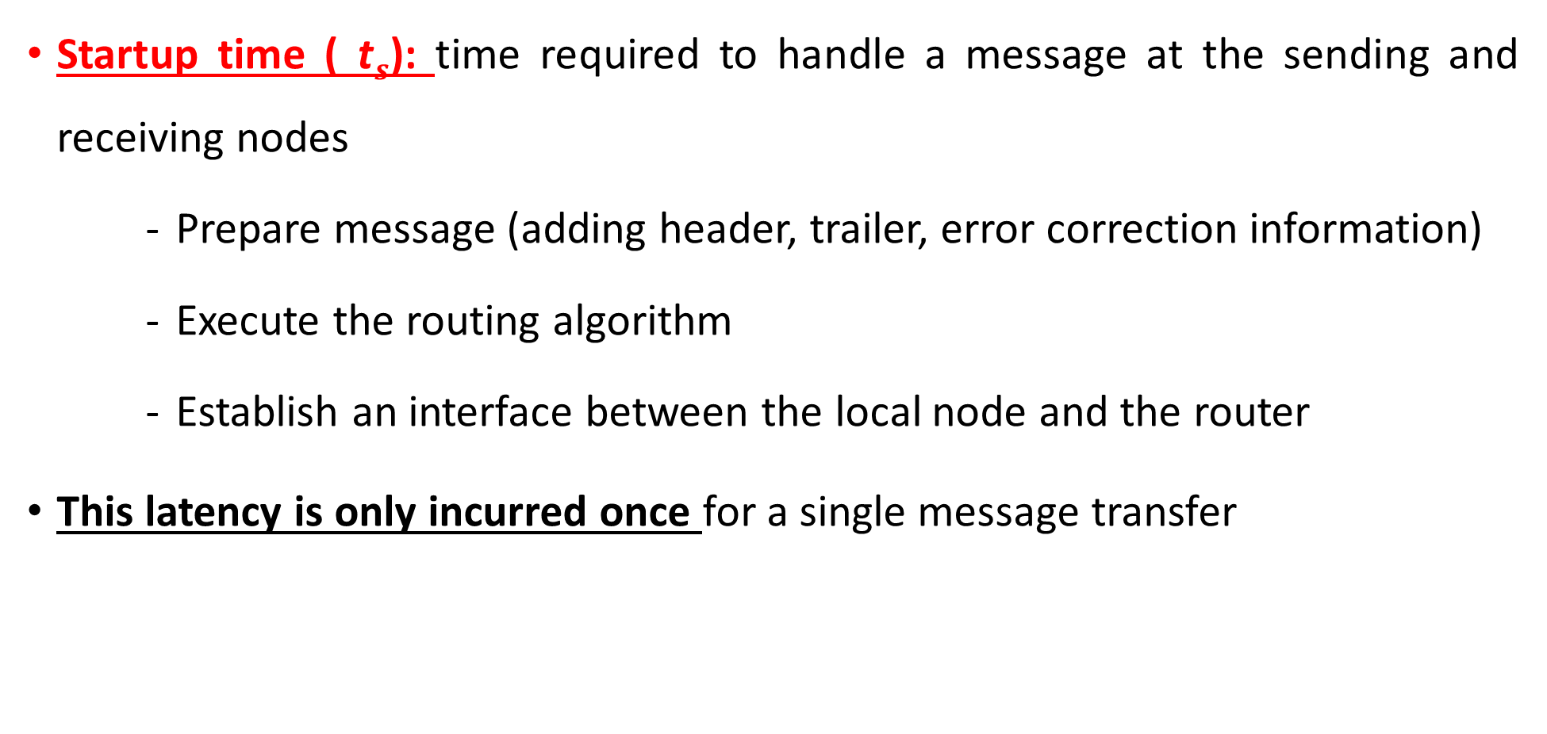
Major Parameters in Communication Costs (I)
Startup time ( t$s$): time required to handle a message at the sending and receiving nodes
Prepare message (adding header, trailer, error correction information)
Execute the routing algorithm
Establish an interface between the local node and the router
This latency is only incurred once for a single message transfer

Slide 12
Major Parameters in Communication Costs (I)
Per-hop Time (t_{h} ):
After a message leaves a node, it takes a finite amount of time to reach the next node in its path.
It is the time taken by the header of a message to travel between two directly connected nodes in the network
It is directly related to the latency within the routing switch for determining which output buffer or channel the message should be forwarded to
The per-hop time is also called node latency

Slide 13
Major Parameters in Communication Costs (I)
Per-word transfer time (t_{w}):
Time taken for one word to traverse a link
This time includes network and buffering overheads
Per-word transfer time is the reciprocal of the channel bandwidth.
If the channel bandwidth is r words per second, then each word takes time t_{w} = 1/r to traverse the link.

Slide 14
Major Parameters in Communication Costs (I)
Per-word transfer time (t_{w}):
Example : if channel bandwidth is 50 words/Minute, then find the per word transfer time

Slide 15
Major Parameters in Communication Costs (I)
Per-word transfer time (t_{w}):
Example : if channel bandwidth is 50 words/Minute, then find the per word transfer time
Solution:
r = Channel bandwidth = 50 Words/Minutes
= 50/60 Words/Seconds
= 0.83 Words/Seconds
T_{w = 1/r = 1/0.83}

Slide 16
Message Routing Techniques
Store-and-Forward Routing
Packet Routing
Cut-Through Routing

Slide 17
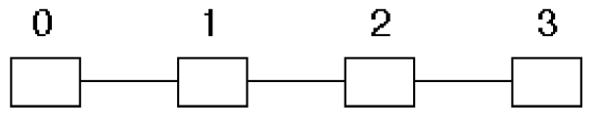
Message Routing Techniques
Store-and-Forward Routing (I)
Technique where the data packets are stored in each intermediate node, before they are forwarded to the next node.
The intermediate node checks whether the packet is error−free before transmitting, thus ensuring integrity of the data packets.
In general, the network layer operates in an environment that uses store and forward packet switching.
illustration

Slide 18

Message Routing Techniques
Store-and-Forward Routing (I)
Total communication cost for a message of size m to traverse a path of l links
Note that the lack of parallelism in utilizing communication resources

Slide 19
Message Routing Techniques
Per-word transfer time (t_{w}):
Example : Suppose there are 10 links, from where a message is sent from source to destination, message took 10 seconds to start it for sending from source to destination. Whereas, the channel bandwidth is 50 words/Minute. Find total communication cost using store-and-forward scheme.

Slide 20
Message Routing Techniques
Example : Ali send a Message and it passes through 10 intermediate links to destination its destination, where each node took 5 Seconds to validate/verify the message. Ali took took 10 seconds to compose/start message for forwarding to Sehar/destination. The channel bandwidth was 50 words/Minute. Find total communication cost using store-and-forward scheme.
Solution:
r = Channel bandwidth = 50 Words/Minutes = 50/60 Words/Seconds = 0.83 Words/Seconds
T_{w = 1/r = 1/0.83}
Using the equation, the result is
T_{comm} = 10+ ( 50 X 1.20 + 5) X 10
₌ 16.5

Slide 21

Message Routing Techniques
Store-and-Forward Routing (II)
For present generation parallel computers, t_{h} is very small
The quantity mt_{w} is much larger. So we usually ignore the per-hop time in store-and-forward routing scheme
The simplified formula is:

Slide 22
Message Routing Techniques
Packet Routing
Connectionless network switching technique.
A long message is cut into pieces
Here, the message is divided and grouped into a number of units called packets that are individually routed from the source to the destination.
Message pieces are sent through the network one followed by another
Store-and-Forward routing makes poor use of communication resources.
A message is sent from one node to the next only after the entire message has been received

Slide 23
Message Routing Techniques
Packet Routing
Advantages:
Better utilization of communication resources
Lower overhead from packet loss (errors)
Packets may take different paths
Better error correction capability

Slide 24
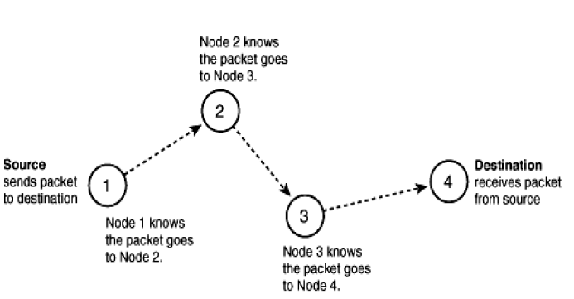
Message Routing Techniques
Packet Routing

Slide 25
Message Routing Techniques
Packet Routing
Packet routing is suited to networks with highly dynamic states and higher error rates, such as local- and wide-area networks.
This is because individual packets may take different routes and retransmissions can be localized to lost packets.

Slide 26
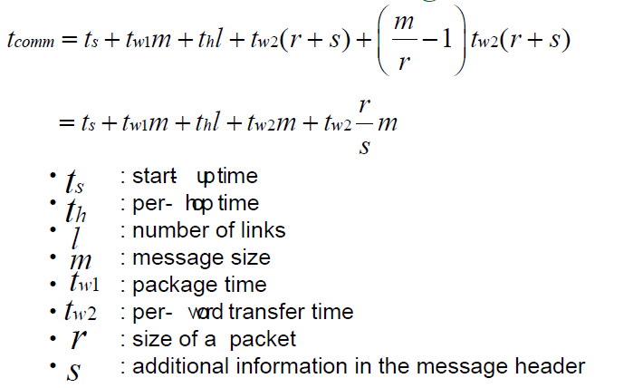
Message Routing Techniques
Packet Routing Cost
Notes:
Packet Routing Cost
Consider the transfer of an m word message through the network.
The time taken for programming the network interfaces and computing the routing information, etc., is independent of the message length. This is aggregated into the startup time ts of the message transfer.
We assume a scenario in which routing tables are static over the time of message transfer (i.e., all packets traverse the same path). While this is not a valid assumption under all circumstances, it serves the purpose of motivating a cost model for message transfer. The message is broken into packets, and packets are assembled with their error, routing, and sequencing fields. The size of a packet is now given by r + s, where r is the original message and s is the additional information carried in the packet.
The time for packetizing the message is proportional to the length of the message. We denote this time by mtw1. If the network is capable of communicating one word every t_{w2} seconds, incurs a delay of th on each hop, and if the first packet traverses l hops, then this packet takes time thl + tw2(r + s) to reach the destination. After this time, the destination node receives an additional packet every tw2(r + s) seconds. Since there are m/r - 1 additional packets, the total communication time is given by:

Slide 27
Cut-Through Routing
A special packet switching for parallel computers with the following properties to reduce cost:
All packets go through the same path
In-sequence delivery
Associate error information at message level
Use lean error detection mechanisms

Slide 28
Flits Communication
Cut-through routing uses flits
A tracer is first sent from the source to the destination node to establish a connection
Flits are sent through the path one after the other
An immediate node forwards the flit as soon as it is received
Buffer space is not necessary at the immediate nodes

Slide 29

Communication Cost of CT Routing
Consider a message that is traversing such a network.
If the message traverses l links, and t_{h} is the per-hop time, then the header of the message takes time lt_{h} to reach the destination. If the message is m words long, then the entire message arrives in time t_{w}m after the arrival of the header of the message. Therefore, the total communication time for cut-through routing is

Slide 30
Communication Cost of CT Routing
Note that it no longer contains the product of message size and number of links
Cut-through routing is fast for large size message and long distance communication
For nearest neighbor communication, store-and forward routing and cut-through routing are similar

Slide 31
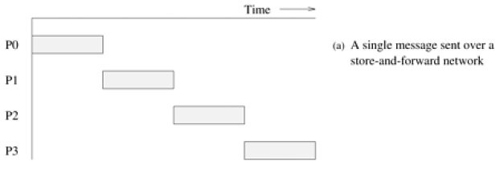
Message Routing Techniques

Slide 32
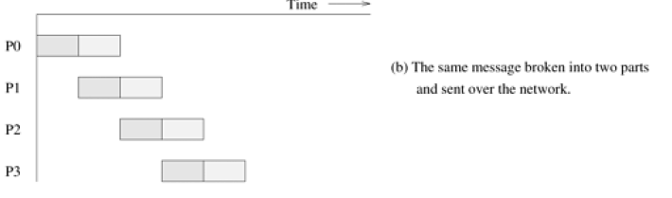
Message Routing Techniques

Slide 33
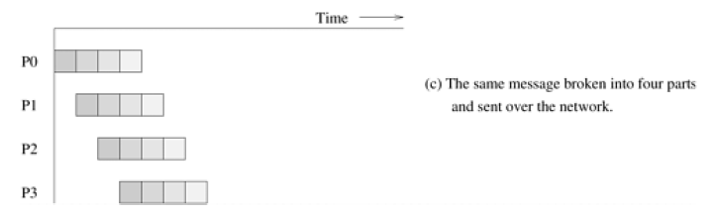
Message Routing Techniques

Slide 34
Routing Mechanisms for Interconnection Networks
Efficient algorithms for routing a message to its destination are critical to the performance of parallel computers.
A routing mechanism determines the path a message takes through the network to get from the source to the destination node.
It takes as input a message's source and destination nodes. It may also use information about the state of the network.
It returns one or more paths through the network from the source to the destination node. Two routing mechanisms:
Minimal and
nonminimal

Slide 35
Routing Mechanisms for Static Networks
Minimal routing
always selects one of the shortest paths between the source and destination node
In a minimal routing scheme, each link brings a message closer to its destination
This scheme could lead to congestion in parts of the network
Non-minimal routing
may route the message along a longer path to avoid network congestion

Slide 36
Routing Mechanisms for Static Networks
Routing mechanisms can also be classified on the basis of how they use information regarding the state of the network
Two possible classes are
Deterministic routing
Adaptive routing

Slide 37
Routing Mechanisms for Static Networks
Deterministic routing
A deterministic routing scheme determines a unique path for a message, based on its source and destination.
It does not use any information regarding the state of the network
Results in uneven use of the communication resources in a network.
Adaptive routing
In contrast, an adaptive routing scheme uses information regarding the current state of the network to determine the path of the message.
Adaptive routing detects congestion in the network and routes messages around it.

Slide 38
Routing Mechanisms for Static Networks
One commonly used deterministic minimal routing technique is called dimension-ordered routing.
Dimension-ordered routing assigns successive channels for traversal by a message based on a numbering scheme determined by the dimension of the channel.
The dimension ordered routing technique for a two-dimensional mesh is called XY-routing and that for a hypercube is called E-cube routing.
Both are deterministic and minimal routing techniques
Both routing schemes are dead-lock free

Slide 39
Routing Mechanisms for Static Networks
XY-Routing Scheme
Message is first sent along the X dimension until it reaches the column of the destination node
Then it is routed along the Y dimension until it reaches the destination
The length of the path is
| S_{x} − D_{x} | + | S_{y} − D_{y} |
Source node: Psx, S_{y}
Destination node : P_{Dx}, D_{y}

Slide 40
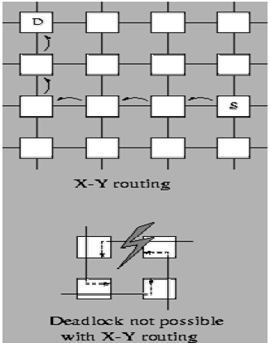
Routing Mechanisms for Static Networks
XY-Routing Scheme

Slide 41
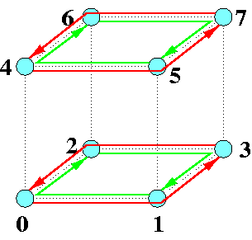
Routing Mechanisms for Static Networks
E-Cube Routing Scheme
The number of links in the path is determined by the binary labels of the source and destination nodes (Hamming distance)
Each step corrects one bit difference, starting from the least significant digit (exclusive-or operation)

Slide 42
Embedding and Graph Mapping
Embedding one network into another is important for porting algorithms
No need to develop algorithms for every network topology
Process-processor mapping is not controlled by the programmer
Mapping can be used to determine the degradation in the performance of an algorithm

Slide 43
Graph Mapping Terminologies
Congestion: Maximum number of edges of E mapped on to any edge in E‘
Dilation: Maximum number of edges of E‘ that any one edge of E is mapped onto That is how much we stretch an edge of E
Expansion: |V' |/| V|
Load: Maximum number of vertices of E that are mapped to a single vertex of E'

Slide 44
Routing Mechanisms for Static Networks
Routing mechanisms can also be classified on the basis of how they use information regarding the state of the network.
A deterministic routing scheme determines a unique path for a message, based on its source and destination does not use network status
An adaptive routing scheme uses information regarding the current status of network to determine the path of message may detect a congestion spot and route message around it

Slide 45
Assignment - Only Hand-Written Accepted

